Slide 1
KV6002 Week 1 – Assignment Briefing and Expectations
Dr Rebecca Nicholson

Slide 2

KV6002 Team Project and Professionalism – Week 1
Today I will:
1. Give an assignment briefing
2. Make clear our expectations
3. Outline what you can expect from us as a module team.

Slide 3
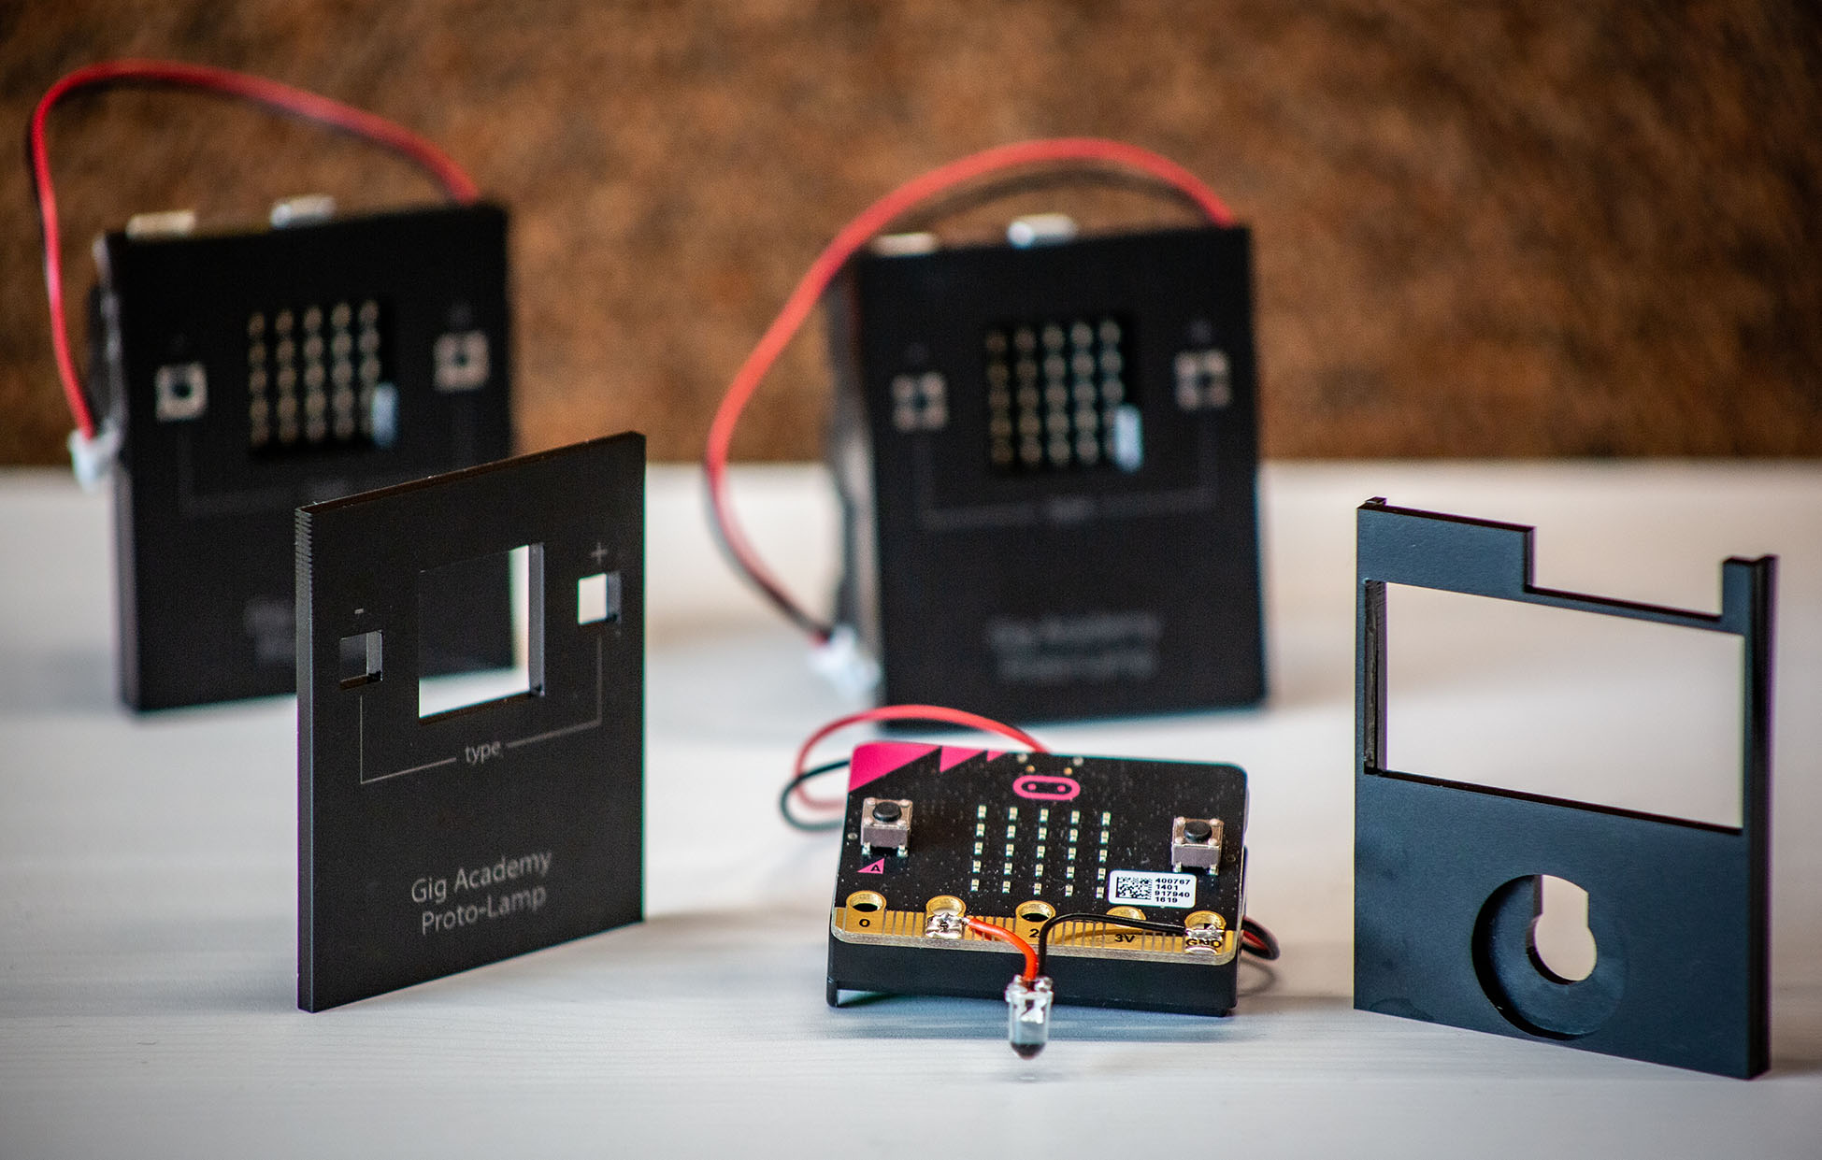
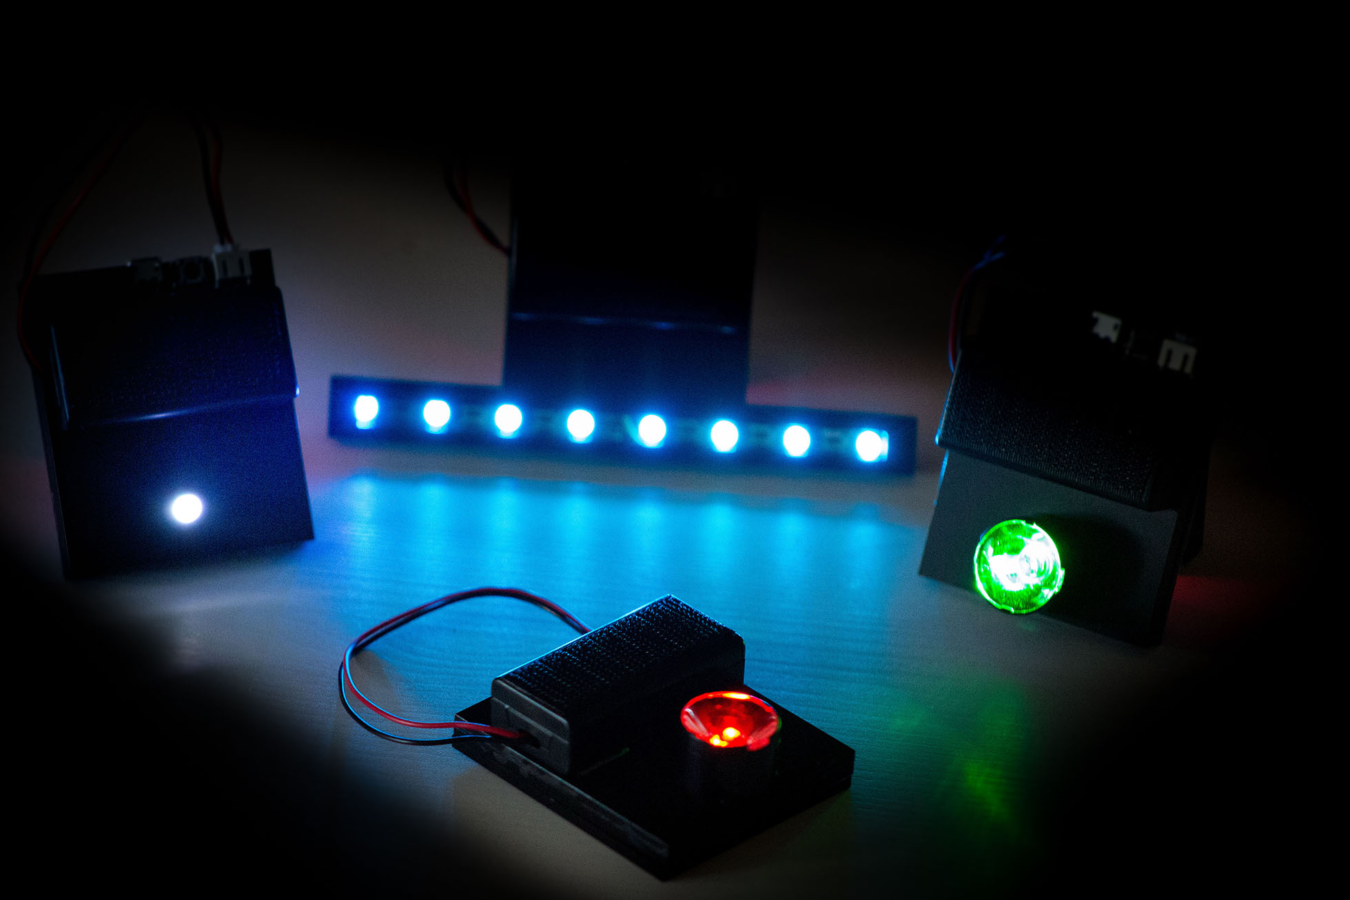
Brief Intro
Module Leader: Dr Rebecca Nicholson
Educational Technology
Build and evaluate technology used in teaching
Music Technology
How do we use tech to teach music / drama?
Human-Computer Interaction
I will ALWAYS ask you about the users!
I specialise in collaborative systems – how to design technology to support collaborative learning teaching.

Slide 4

Assessments
Project Plan (10%)
Submit and present your project plan to your supervisor as a group.
2. Product Demonstration (50%)
Demonstrate your product to your supervisor and second marker as a group.
3. Evaluation Report (40%)
Write a reflective report on your own contributions to the group and how well your product matched the plan.

Slide 5

Deadlines
Jan 20th 2023
Submit team members and project idea (0%).
9th Feb 2023
Assessment 1 (Project Plan) – 10%
w/c 13th Feb 2023
Presentations to supervisors.
26th Mar 2023
Final Demonstration – 40%
11th May 2023
Reflective Report - 40%

Slide 6
Assignment 1 - Overview
Submission: Slide deck for presentation.
This version will be used for your presentation
Deadline: 9th Feb 2023
Presentation: During week 3 supervision session.
Feedback: Verbal - on the day you will be asked questions / get feedback.
Written feedback – 3 specific improvements agreed with your supervisor.
(Nb - When we mark the demo we expect to see these have been actioned)

Slide 7
Assignment 1 Expectations
You give a clear presentation outlining all the key aspects of your project.
There is a list of the slides we expect you to include as part of the assessment.
You MUST adhere to the slide limit. This is fixed at 14 slides. You will only have 15 minutes to give your presentation so make sure you don’t create too many slides!

Slide 8
SLIDE 1
This slide should contain:
Information about your client
Their initial ‘pitch’ (what they wanted you to develop at a high level).
Introduce your group – who is in the team?
How you gathered the requirements for your system and refined them.

Slide 9
SLIDE 2 & 3
Your epic in the specified format
Your team plan outlining how your features work together as a plan.
This plan should include:
details of the overall system,
who will complete which subsystem
how you intend to test the system, and
integration of the subsystems.
Project requirements – what equipment / software access do you need?
Potential commercial, economic, legal, ethical, social and professional factors

Slide 10
SLIDE 2 EPIC EXAMPLE
For: [The user group] Who: [Problem] Our: [Type of system] Is a: [Outline project idea] That: [How it solves the problem] | For Northumbria students Who need to find good coffee Our mobile app Is a good coffee finder That will show students ratings and locations.

Slide 11
SLIDE 4 – Intended Users
This slide should contain:
1 persona per person in the group.

Slide 12

Bio
This gives some background info to help you understand the person.
Currently Uses Regularly:
Devices
Understanding what devices they will use is key.
Listing the apps they use regularly can give insight into the types of interactions they like
AGE
OCCUPATION
LOCATION
DIG LITERATE
Brief info to help you know who the potential user is.
Requirements
Frustrations
Understanding what they want from the app / software / website can give you ideas for functionality.
Understanding what they don’t like about their current solution helps you to avoid repeating things they don’t like.
Quote
A quote helps you to imagine what they might say about your design.

Slide 13


Bio
She is CEO of an online retailer that specialises in sportswear and equipment. She took over as CEO 6 months ago and in her spare time likes to travel and mountain bike.
Currently Uses Regularly:
Devices
Phone (iPhone)
iPad
Macbook
AGE
OCCUPATION
LOCATION
DIG LITERATE
32
CEO
NEWCASTLE, UK
HIGH
Requirements
Frustrations
View sales in one place
Easily adjust the visualisations
Download data quickly to all devices.
Current data format doesn’t work on all devices.
Difficult to change the view.
Have to check different places for all the data.
Quote
“I need something that’s easy to learn how to use otherwise I won’t bother”

Slide 14
SLIDE 5 onwards
These slides should include:
A clear outline of the subsystem you are working on.
5 user stories (these should all be connected to one of your group personas).
A clear outline of the tasks you intend to complete and the deliverables.

Slide 15
User Stories
As a <role> I want <something> so that <benefit>
As a CEO I want to understand who brought in which clients so I can support them with their workload.

Slide 16
Assignment 2 - Overview
Submission: Recorded demo & Peer Assessment.
Peer Assessment – you need to keep a weekly log - screenshot based. I expect peer assessment feedback to be accompanied by reference to this. No unsubstantiated claims!
Deadline: 26th March 2023 (before Easter)
Viva: W/c 17th April in the usual supervision slot.
Feedback: Written feedback posted on Blackboard.

Slide 17
Weekly Log
Has to be submitted with your assignment 2 demo.
Peer assessment decisions and peer reflections in your assignment 3 report MUST be cross referenced to this log.
E.g. you say ‘xx did not respond to emails until week 8’ – you need to cross reference.
‘xx did not respond to emails until week 8, despite repeated attempts to contact them (see page 3 of the log).

Slide 18
Assignment 2 Expectations
A functional project demonstrating you have met the requirements of your stakeholder.
There should be as many subsystems as there are members of the team.
These subsystems should be well integrated into one cohesive and functional system.
You should demonstrate you met requirements from your stakeholder AND feedback from your presentation.

Slide 19
Assignment 2 Expectations
Complex system = functional prototype
Less complex = higher expectations of the end product.
Talk to your supervisor about your plans & they can discuss our expectations.

Slide 20
Assignment 3 - Overview
Submission: Written reflective report.
Peer Assessment – you need to keep a weekly log - screenshot based. I expect peer assessment feedback to be accompanied by reference to this. No unsubstantiated claims!
Deadline: 11th May 2023
Feedback: Written feedback posted on Blackboard.

Slide 21
Assignment 3 Expectations
A well written report outlining how well your team met the expectations and requirements of your stakeholder.
It should reflect clearly (and dispassionately) on problems encountered along the way.
It should give clear reflections on what you would do differently next time.
There should be detailed reference to PLSEC Issues and this should me more than surface lever considerations.

Slide 22
We expect you to:
Attend weekly supervisions
Keep weekly logs of your project progress and teamwork
Make every effort to solve teamwork issues yourselves
Where this is not possible – speak to your supervisor ASAP.
Offer fair and substantiated peer feedback to your team mates.

Slide 23
Use of tools / frameworks etc.
Fine (frankly it’s encouraged).
We expect you to create a functional system in response to your client’s brief. This should model the real world (it’s your last chance to work on your skills before you graduate).
Use your knowledge of best practice / good tools to help you.

Slide 24
Even Chat GPT?
Yes, with caveats.
Be open with your use – it’s a great tool and can be super helpful.
However,
Make sure you understand your code and can explain it in detail. Explain how and why you used the tool (what did you gain / why was that the right tool for that purpose).

Slide 25
You can expect from us:
An assigned supervisor for your team.
Support with team formation and finding a project.
10 x 30 minute supervisions. Once a week in weeks 2 to 11.
Supportive feedback on your project
Please note – specific technical feedback may be limited.
Weekly lectures with advice and guidance.
This will always include opportunities for questions.

Slide 26
You can expect from us:
Lecture videos uploaded online for those who miss lectures.
Powerpoints available prior to the lecture from week 2.
Clear set of minimum targets for each week.
These are not marked but could help keep you on track!
Updated FAQ section on Blackboard.
As people ask questions I will add them here.
Briefs will be available with this powerpoint after the lecture.
In future powerpoints will be available BEFORE the lecture.

Slide 27
Module Timetable
Friday Lecture – with Rebecca
Guidance on aspects of the process
Minimum expectations for the week ahead
Weekly Supervisions – with supervisors
Specific tailored project guidance
At a time to suit you and your supervisor
If you can’t make it please let them know in advance / try and rearrange

Slide 28

Who do I contact for advice?
Firstly – your supervisors
They know you / your team project
Can provide specific advice
They are experts
As a last resort – me.
Not because I don’t want to talk to you but because my response will be slower and probably less tailored to you and your team.
Remember there are 140 on the module and one of me!

Slide 29
Week 2 expectations.
As a minimum you need to have:
Met with your team
Met with your supervisor
Planned a meeting with your client
Some supervisors are advising you to speak to them before your first meeting with them. This is fine – I will be going over gathering requirements next week so timing of this is up to you.
Set up a team working area. This can be Teams / Discord / Slack / other of your choice.

